Slide 1
Atulya iot project
Name- stavan brahmbhatt
Admission no.-21je0248
Branch- engineering physics

Slide 2
WEARTHER REPORT DEVICE
INNOVATIVE DEVICE TO MEASURE TEMPERATURE AND HUMIDITY.

Slide 3
importance OF (REALTIME) WEATHER REPORT
A farmer can’t fight the weather. However, he can adopt the given situation and take additional farm management practices to minimize crop losses. Therefore, accurate information regarding the weather is important so that farm activities can be planned without adverse events. USING A GENRILIZED WEATHER REPORT SYSTEM DOES NOT PROVIDE ACCURATE INFORMATION ABOUT THE SPECIFIC AREA. Being aware of real-time weather conditions like air and dew temperature and humidity is the best way to protect crops and secure a high and healthy yield. TO CREAT A MORE ACCURATE WEATHER REPORT I HAVE CREATED A DEVICE TO HELP IN AGRICULTURAL FIELD.

Slide 4
APPARATUS
ESP32 DEVELOPMENT KIT, POTENTIMETER(0 TO 3.3 V), Dht1 SENSOR(TEMPERATURE AND HUMIDITY SENSOR), LED LIGHT, CONNECTION WIRES.

Slide 5
APPARATUS DESCRIPTION

Slide 6
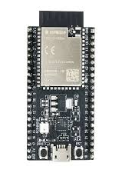
ESP32 DEVELOPMENT KIT
When it comes to Internet of things, the ESP32 is a chip that packs a powerful punch. This low-cost, low-power system on a chip (SoC) series was created by Espressif Systems. Based on its value for money, small size and relatively low power consumption, it is well suited to a number of different Internet of things applications.

Slide 7
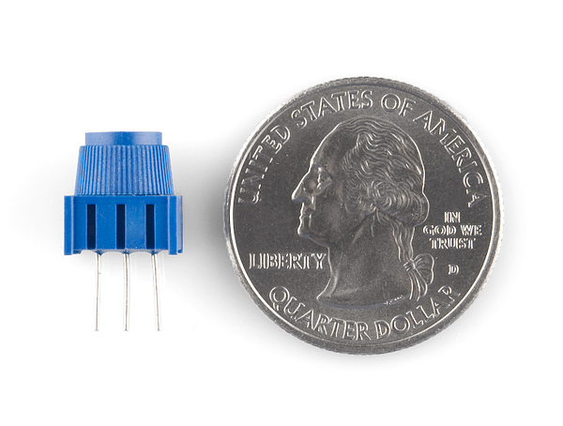
POTENTIMETER
A potentiometer is a variable resistor that can be adjusted by sliding, rotating, or another type of physical interaction.
With the help of potentiometer the analog input pin converts the voltage (between 0v and 3.3V) into integer values (between 0 and 4095), called analog value. We can connect the potentiometer's output pin to an ESP32's analog input pin, and then read the analog value from the pin

Slide 8
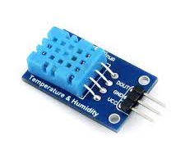
Dht11 SENSOR
DHT11 is a Humidity and Temperature Sensor, which generates calibrated digital output. DHT11 is a low cost humidity and temperature sensor which provides high reliability and long term stability.
It uses a capacitive humidity sensor and a thermistor to measure the surrounding air, and outputs a digital signal on the data pin (no analog input pins needed). This module makes is easy to connect the DHT11 sensor to a microcontroller as includes the pull up resistor required to use the sensor. Only three connections are required to be made to use the sensor - Vcc, Gnd and Output

Slide 9
BLOCK DIAGRAM

Slide 10
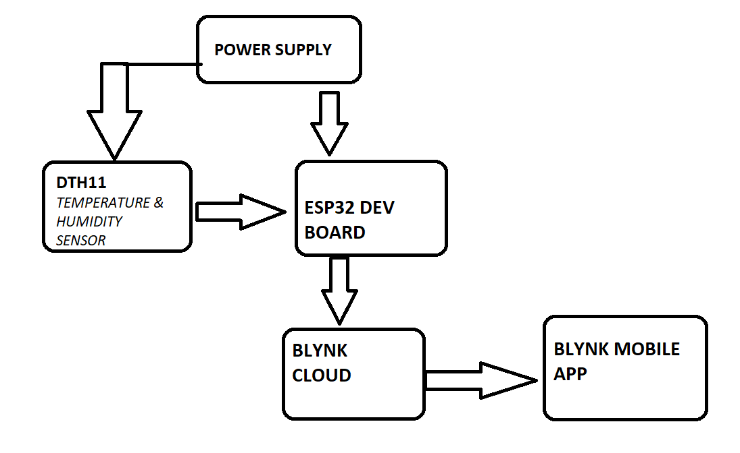

Slide 11
DEVICE DISCRIPTION
I HAVE USED AN ESP32 DEVELOPMENT BOARD WHICH HAS A INBUILT WIFI MODULE. WHICH IS CONNECTED TO A DTH11 SENSOR TO MEASURE HUMIDITY AND TEMPERATURE OF SURROUNDING.I HAVE USED A POTENTIOMETER TO CONVERT ANALOG INPUT INTO INTEGER VALUE (RANGE 0 TO 4095).I HAVE CONNECTED A LED FOR TEST PURPOSE.I HAVE USED BLYNK SOFTWARE TO CONNECT THE ESP32 BOARD TO CLOUD,WHICH PROVIDES REALTIME WEATHER UPDATE DIRECTLY TO BLYNK MOBILE APP.

Slide 12
THANK YOU!

